Slide 1
Prenatal Care
Credit: Open Clip Art.org with Creative Commons License 1.0. Available at https://openclipart.org/image/800px/327713
Susan E. White MD, FACOG
Assistant Professor of Obstetrics & Gynecology
Boston University Chobanian & Avedisian School of Medicine ​
Physician Assistant Program
Prenatal Care Workshop created by Susan E. White. Available at APAOG and licensed under Creative Commons License 4.0 CC BY-NC 4.0. Copyright 2023 Susan E. White.

Slide 2
Gender Terminology ^{[1]}
In this presentation the terms maternal or mother refer to a pregnancy capable person.
Sex
Biological status assigned at birth
Typically categorized on basis of external anatomy
Gender
Internal sense of self and gender
May or may not conform with sex
Pregnancy capable person
Person who is biologically capable of becoming pregnant
Gender may be male, female, non-conforming or non-binary
Maternal
Traditionally refers to a person who is pregnant or is has recently given birth
Data sources (CDC, WHO etc.) assume maternal refers to sex
Little to no data on pregnancy capable people with other gender identities.
Notes:
Defining the terms used in the presentation. Data sources such as the CDC, WHO, Census etc. assume that all patients who have morbidity and mortality associated with pregnancy are biological females. The data does not take into account gender and is often labeled as maternal and the data points labeled as mothers. Likewise, birth rates also assume female sex.

Slide 3
Outline of Prenatal Care Presentation
History of Prenatal Care in the US
Vocabulary and Terms
Diagnosis of Pregnancy
Determining Gestational Age and Estimated Date of Delivery (EDD)
Prenatal Care
First trimester (1 week - 13 weeks 6 days)
Second trimester (14 weeks - 28 weeks 6 days)
Third trimester (29 weeks - 41 weeks 6 days)
Common prenatal problems
Prenatal Physical Examination

Slide 4
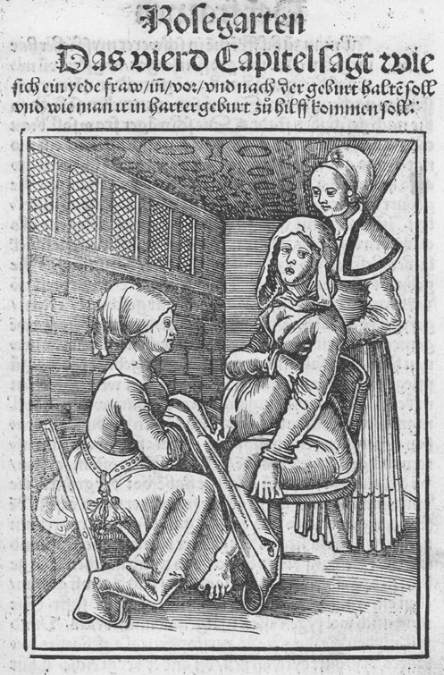
Midwives and Obstetrics
Midwife derives from the Angelo Saxon terms – mid (with) and wyf (woman) ^{[2]}
Obstetrics is from Latin, meaning to ‘stand before’ ^{[2]}
This is an illustration from Chapter 4 of the 2nd Edition of the earliest printed textbook for midwives, Eucharius Rößlin, Der Swangern frawen vnd hebamme(n) roszgarte(n). Hagenau: Gran, um 1515.
A woman giving birth on a birth chair.
Credit: Public Domain, https://commons.wikimedia.org/w/index.php?curid=665852

Slide 5
History of Prenatal Care^{[2,3]}
Traditionally, midwives provided home based childbirth care and were trained with an apprentice model.
1765 – First formal training school for midwives opens ^{[2]}
Late 1800s – Some large city hospitals open prenatal clinics. ^{[3]}
Votive pregnant female, Roman, 200 BCE-200 CE Wellcome L0058442.jpg
Credit: Wellcome Images, a website operated by Wellcome Trust, a global charitable foundation based in the United Kingdom. Via Wikimedia Commons and available at https://wellcomecollection.org/works/pq2ng4qh?wellcomeImagesUrl=/indexplus/image/L0058442.html

Slide 6
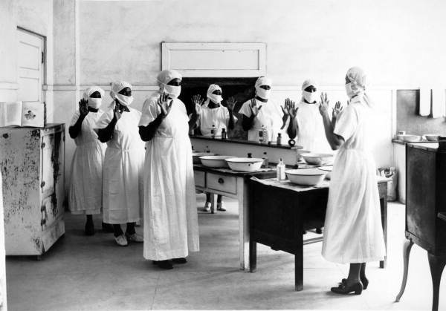
History of Prenatal Care - 1900s ^{[3]}
Hospital Births increase
50% in 1921
80% by 1950
97% by 1960
Prenatal care moves from home visits to clinics
Photo Credit: Public domain. Available at http://www.floridamemory.com/items/show/44692
Sterile procedures taught to midwives for licensing, Miami, Dade County, Florida, 1935.

Slide 7
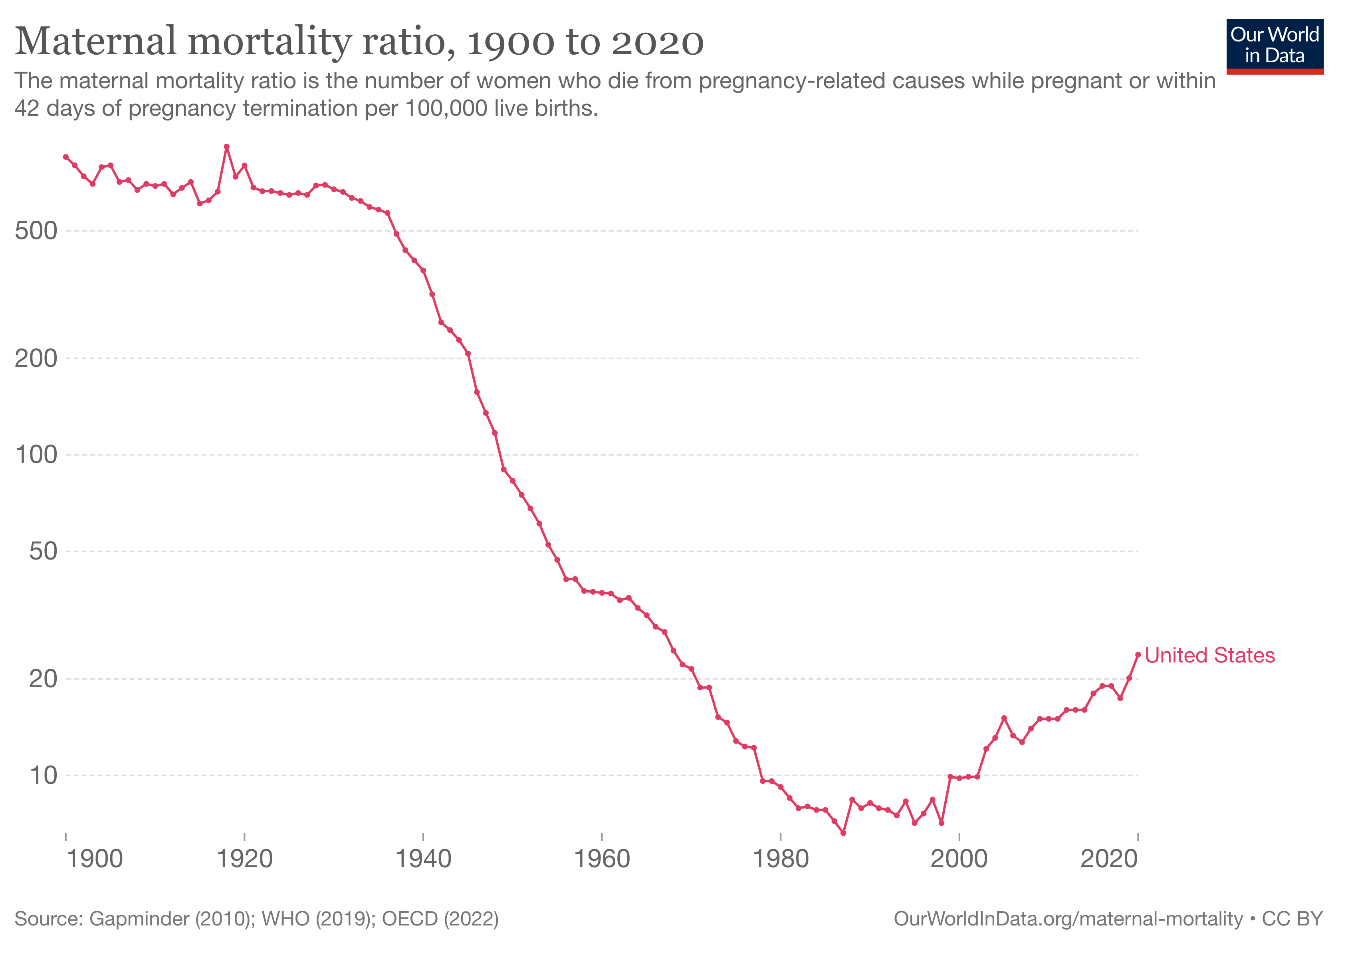
Maternal Death Rates ^{[4]}
Penicillin 1942
Oxytocin, 1950s
Max Roser and Hannah Ritchie (2013) - "Maternal Mortality". Published online at OurWorldInData.org. Retrieved from: 'https://ourworldindata.org/maternal-mortality' [Online Resource]. Accessed January 3, 2023. ^{[4]}
Notes:
Two developments lowered the matinal death rate – pencil lien for poster partum infection (childbed fever) in 1942 and oxytocin for prevention and treatment of postpartum hemorrhage as well as labor.

Slide 8
Top 3 Things to Remember About Prenatal Care and Pregnant Patients
Make sure the pregnancy is in the uterus
Normal BP in pregnancy is not 120/80
Pregnancy is a risk for thromboembolism
Many lab values are different

Slide 9
Outline of Prenatal Care Presentation
History of Prenatal Care in the US
Vocabulary and Terms
Diagnosis of Pregnancy
Determining Gestational Age and Estimated Date of Delivery (EDD)
Prenatal Care
First trimester (1 week - 13 weeks 6 days)
Second trimester (14 weeks - 28 weeks 6 days)
Third trimester (29 weeks - 41 weeks 6 days)
Common prenatal problems
Prenatal Physical Examination

Slide 10
Vocabulary of Obstetrics
Trimesters
First - week 1 to 13 weeks 6 days
Second – 14 weeks 1 day to 28 weeks 6 days
Third – 29 weeks 1 day to 41 weeks 6 days
LMP (Last Menstrual Period)
Sometimes also called LNMP (Last Normal Menstrual Period)
Notes:
The vocabulary of obstetrics is unique. The Prenatal Care Workshop contains a worksheet and answer guide for Obstetrical Terms and some are discussed here. Educators may want to have students completer the worksheet before class and review here or may use it as an in-class or after class assignment.

Slide 11
Vocabulary of Obstetrics
Gestational Age
Calculated from the LMP, not ovulation
From LMP to ovulation there are about 14 days in a 28-day cycle
Standard practice is to include those 2 weeks from LMP to ovulation when calculating the gestational age even though the pregnancy occurs after ovulation.
Full term pregnancy is 40 weeks from LMP
Notes:
Use of the LMP to calculate gestational age is used in ultrasound reports and medical literature as a universal standard in the US.

Slide 12
Vocabulary of Obstetrics
Term Pregnancy ^{[6,7]}
Early term: 37 weeks through 38 6/7 weeks
Full term: 39 weeks through 40 6/7 weeks
Late term: 41 weeks through 41 6/7 weeks
Post term: 42 weeks and beyond
EDD (Estimated Date of Delivery)
sometimes also called EDC (Estimated Date of Confinement)
Notes:
The term confinement comes from the Victorian practice of confining pregnant patients at term and after delivery to their home.

Slide 13
Gravidity and Parity
Gravidity
Pregnancy, no matter what the outcome
Parity
Birth of infant > 500 gm. or >20 weeks
Does not refer to number of infants born
Adding prefixes
Nulla means zero as in nulliparous (no births)
Primi means first as in primigravida (first pregnancy) or primipara (first baby)
Multi means more than one as in multiparous (>1 birth)
Notes:
One way to think about parity is that it refers to number of times in the delivery room, no mater how many babies are born.

Slide 14
Gravity and Parity
A G1 P1 is used for a pregnancy capable person with one singleton birth or who had twins or even triplets.
F-P-A-L system – defines parity
F – P – A – L
F = full term
P = premature
A = abortions/miscarriages
L = living children
For twins born at term: G1, P 1-0-0-2
For premature twins: G1, P 0-1-0-2
If one premature twin died: G1, P 0-1-0-1
Notes:
A mnemonic for FPAL is Florida Power and Light.

Slide 15
Outline of Prenatal Care Presentation
History of Prenatal Care in the US
Vocabulary and Terms
Diagnosis of Pregnancy
Determining Gestational Age and Estimated Date of Delivery (EDD)
Prenatal Care
First trimester (1 week - 13 weeks 6 days)
Second trimester (14 weeks - 28 weeks 6 days)
Third trimester (29 weeks - 41 weeks 6 days)
Common prenatal problems
Prenatal Physical Examination

Slide 16
Diagnosis of Pregnancy - Presumptive Signs
Amenorrhea
Nausea and vomiting
Hyperemesis gravidarum
Mastodynia
Fatigue
Quickening
18 - 20 weeks primigravida
14 - 16 weeks multigravidas
Urinary symptoms
Frequency
Nocturia
Positive home pregnancy test
Notes:
There are presumptive signs, probable signs and probably signs of pregnancy. Mastodynia refers to breast tenderness. Quickening is the pregnancy capable person’s report of fetal movement.

Slide 17
Diagnosis of Pregnancy – Probable Signs
Softening of the cervix (Hegars Sign*)
Blueish discoloration of cervix (Chadwicks sign*)
Enlarged uterus
*The names of the signs are for historical context only although some clinicians may still use them
Notes:
Student may encounter the names of these probable signs of pregnancy on rotation or in texts.

Slide 18
Diagnosis of Pregnancy – Positive Signs
Pregnancy test positive
Urine versus serum tests
Both identify the β sub-unit of Human Chorionic Gonadotropin (HCG)
Urine turns positive at 5 – 50 mIU/mL and is either positive or negative
Serum qualitative turns positive at 2 -4 mIU/mL
Quantitative serum HCG gives numerical level
Fetal Heart Tones
Audible on electronic doppler at 10 -12 weeks gestation
Palpable Fetal Parts
Fetus seen on ultrasound
Palpable fetal movement

Slide 19
Outline of Prenatal Care Presentation
History of Prenatal Care in the US
Vocabulary and Terms
Diagnosis of Pregnancy
Determining Gestational Age and Estimated Date of Delivery (EDD)
Prenatal Care
First trimester (1 week - 13 weeks 6 days)
Second trimester (14 weeks - 28 weeks 6 days)
Third trimester (29 weeks - 41 weeks 6 days)
Common prenatal problems
Prenatal Physical Examination

Slide 20
Calculating Estimated Date of Delivery (EDD) ^{[5]}
Methods assume 28-day cycle with regular menses
EDD is assumed to be 40 weeks or 280 days from LMP
EDD is sometimes called Estimated Date of Confinement (EDC)
Interchangeable terms
Confinement refers to practice of confining pregnant patients to home after delivery
Confinement was the medically and socially acceptable practice before the 1900s.
Notes:
The Estimated Date of Delivery (EDD) is sometimes called Estimated Date of Confinement (EDC). The two abbreviations and terms are equivalent and interchangeable. Confinement refers to the practice of having pregnancy capable people confined to their homes after delivery which was the socially and medically accepted practice before the 1900’s.

Slide 21
Gestational Wheels and Calculators
Pregnancy App
LMP
LMP = Day 1 of Last Menstrual Period
DOC = Date of Conception
EDD = Estimated Date of Delivery
EGA = Estimated Gestational Age
DOC
EDD
Feb
Mar
EGA
Jan
Apr
Dec
May
LMP
Nov
EDD
June
Oct
July
Credit: illustration by Susan White
Sept
Aug
Notes:
Originally called a wheel as it was constructed as two independently circular shapes before computers and apps. Wheels were used to calculate gestational age and EDD and are less accurate than electronic apps. ^{[6]} Pregnancy calculators within electronic medical records allow the obstetrical team to use the same tool.

Slide 22
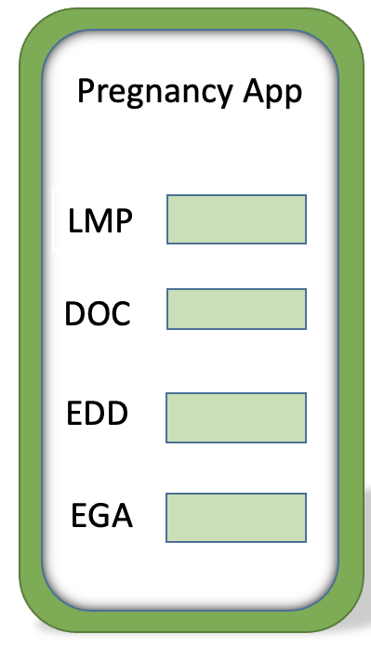
Calculating Estimated Date of Delivery (EDD) ^{[5,6]}
Pregnancy calculators/apps assume a 28-day cycle with regular menses
Gestational App
Calculates weeks and days after LMP
Calculates EDD from ultrasound data
Enter the date of the ultrasound and weeks/days to calculate the EDD
Calculates gestational age during the pregnancy (EGA)
More accurate than paper wheels ^{[6]}

Slide 23
Dating Criteria
LMP
Ultrasound – most accurate under 12 weeks
Pelvic exam
With experienced examiner 8 – 12 weeks sizing is accurate in absence of fibroids
Week 6: Plum or golf ball size
Week 8: Tennis ball size
Week 10: Large orange or softball size
Week 12: Grapefruit size
Week 20: At the umbilicus
Fetal heart
Usually heard by Doppler at 10 – 12 weeks
Notes:
The most accurate dating is an ultrasound under 12 weeks where EDD range is +- 6 days. The range for LMP determination of EDD is +/- 2 weeks.

Slide 24
Notes about EDDs ^{[5,6,7]}
An EDD is determined using LMP and first trimester ultrasound
Once set, EDD should not be changed
The EDD should be communicated with the patient as an estimate and not a firm delivery date.
In some instances, the date of conception (DOC) may be more accurate than LMP
Artificial insemination
Single sexual encounter
For pregnancies resulting from assisted reproductive technology, the age of embryo and date of transfer should be taken into account.

Slide 25
Outline of Prenatal Care Presentation
History of Prenatal Care in the US
Vocabulary and Terms
Diagnosis of Pregnancy
Determining Gestational Age and Estimated Date of Delivery (EDD)
Prenatal Care
First trimester (1 week - 13 weeks 6 days)
Second trimester (14 weeks - 28 weeks 6 days)
Third trimester (29 weeks - 41 weeks 6 days)
Common prenatal problems
Prenatal Physical Examination

Slide 26
First Prenatal Visit – History ^{[8]}
Present pregnancy
Determine EDC
Symptoms and complaints
History
Previous pregnancies
Length of gestation
Birth weight
Fetal outcome
Length of labor
Type of delivery
Complications
Prenatal
Delivery and labor
Postpartum
Notes:
The first prenatal visit usually occurs in the first trimester. If it is later, then the full history, exam and labs are done with testing applicable to the gestational age. For full details and guidance on prenatal care please see Refence 8. American Academy of Pediatrics and the American College of Obstetricians and Gynecologists. Guidelines for Perinatal Care. 8th Ed. Jointly published by AAP and ACOG. ISBN: 978-1-61002-087-9 (AAP) ISBN: 978-1-934984-69-7 (ACOG). 2017.

Slide 27
First Prenatal Visit – History
Medical history
Transfusion history
Exposure to toxins (tobacco, environmental etc.)
Exposure to infectious disease
Medications
Surgical History
Uterine surgery
Abortions/miscarriage
Notes:
History notes: Transfusions may result in development of antibodies in the patient which can then cross into the fetus and cause complications. These antibodies (Kell, Duffy etc.) can cause isoimmunization and can compromise the growth and development of the fetus. Isoimmunization may also cause hydrops fetalis much like Rh isoimmunization if the fetus has the antigens. The presence of antibodies is tested in the blood typing which is part of routine prenatal labs.
It is important to ask about occupational and recreational exposures such as gardening, painting, leather or wood working. This includes cleaning products, well water testing for arsenic, mercury exposure (dental workers) and lead (stain glass artists, painters, artists, construction workers). There are potential occupational concerns for medical workers, teachers, day care workers, those working in hair or nail salons and with animals.

Slide 28
First Prenatal Visit – History
FH
Diabetes may increase risk of gestational DM
Twins
Dizygotic twinning maternal inheritance
Pedigree of three generations
SH
Ethnicity
Occupation
Animals
Hobbies
Alcohol, smoking, cannabis and substance use
Nutrition
Exercise
Domestic violence
Notes:
Domestic violence often increases during pregnancy and is a concern for the wellbeing of the patient and fetus.

Slide 29
Smoking, Alcohol, Cannabis and Substance Use in Pregnancy
Ideally, all should be stopped before conception
Complications include:
Fetal growth restriction
Increased risk of stillborn
Increased risk of premature labor/birth
May increase risk of miscarriage
May damage fetal tissues and the damage may be permanent

Slide 30
Genetic Counseling ^{[9]}
Examples of Autosomal Recessive Diseases | Carrier frequency
Sickle cell | 1/10
Cystic fibrosis | 1/25
Tay-Sachs disease | 1/30
Thalassemia | 1/25
Genetic counseling
Age at time of delivery
Family history
Previous pregnancy history (history of a genetic issue)
Anomaly seen on ultrasound
Autosomal recessive diseases
Refer to genetic counselor
Fetal Tissue
Amniocentesis
Chorionic villi sampling
Plasma
Notes:
The ability to test for genetic diseases is increasing rapidly and patients should be offered a visit with a genetic counselor early in the pregnancy. As both males and females can be carriers, it is important to include both in the counseling and testing. If both are carriers of an autosomal recessive disease then there is a 25% of the fetus inheriting both recessive genes and developing the disease.

Slide 31
Maternal Age > 35 Risks ^{[9]}
Risk of Trisomy 21
Age 20 1/1,667; Age 35 1/378; Age 40 1/106
Risk of other chromosomal abnormalities
Age 20 1/526; Age 35 1/192; Age 40 1/66
Testing is offered but not required

Slide 32
First Prenatal Visit - Physical Exam
Vital signs, height, weight
Complete physical examination
Pelvic exam
Uterine size
Pap smear
Gonorrhea and chlamydia
Fetal heart tones if EGA >10 weeks
Notes:
The fetal heartbeat can be heard using a specialized doppler head at about 10 weeks. Body habitus, multiple gestations and fibroids may limit audibility.

Slide 33
First Prenatal Visit - Labs
CBC with differential
Blood type, Rh and antibody testing
Rubella and varicella immunity
Hepatitis B and C
Tuberculosis testing
HIV
Syphilis
Urine analysis
Culture and dipstick
Notes:
These are general recommendations and additional labs may be needed based on patient history and physical exam. Asymptomatic urinary tract infractions are common in pregnancy. Some lab values have normal values which are different for pregnancy such as creatine and hematocrit which are both affected by hemodilution and are therefore lower.

Slide 34
Labs if at Risk
Toxoplasmosis
Immune testing for those at risk of exposure to chickenpox, hepatitis etc.
For previous history of gestational diabetes, previous baby over 4000 gm, strong FH of DM or obesity
One-hour glucose test in first trimester
50 gm load of glucose
Glucose level tested 1 hour later
Notes:
Risks for toxoplasmosis include exposure to cat feces. Patients who have cats and clean litter boxes may be exposed to toxoplasmosis. Patients who live in area with feral cat population or may be exposed through exposure to earth with cat fecal material such as landscapers or those who garden maybe also be at increased risk.

Slide 35
Other First Visit Considerations
Request old records and/or operative reports
Genetic counseling ^{[9]}
Nutritional counseling
Guidance for exercise
Prenatal vitamins
0.4 mg folic acid for first 6 weeks
Vitamin B12 for vegetarians
Ultrasound for dates
Notes:
Operative reports are needed for previous uterine surgery such as myomectomy or C-Section. Surgeries and the resultant scarring of the uterus may increase the risk of uterine rupture. The operative report is an important tool for shared decision making in terms of delivery options and risks.

Slide 36
First Visit Recommendations
Weight gain
Increase calories by 300 per day
Pre-pregnant BMI | Suggested weight gain (pounds)
< 19 | 28 – 40
19 -25 | 25 -35
>25 | 15 -25

Slide 37
First Visit Recommendations
Exercise
Avoid supine exercise after first trimester
Avoid risk of falling or abdominal trauma (skiing, skating, wake boarding etc.)
Fall risks increase as pregnancy grows
Avoid hot tubs and saunas
Avoid alcohol
Avoid smoking and secondhand smoke
Avoid substance use
Notes:
Exercise recommendations should be tailored to the patient’s interests and current level of exercise level.

Slide 38
First Trimester Prenatal Visits
Visits every 4 weeks
BP, weight, urine dipstick for protein/glucose at each visit
Visit at 10 – 12 weeks for fetal heart
Genetic counseling/testing if needed ^{[9]}
Labs as needed ^{[8]}
Notes:
Testing recommendations vary to accommodate concerns raised by medical history and current pregnancy issues. There are also regional differences in the types and timing of testing so specific recommendations for testing are beyond the scope of this workshop. See Reference 8 - American Academy of Pediatrics and the American College of Obstetricians and Gynecologists. Guidelines for Perinatal Care. 8th Ed. Jointly published by AAP and ACOG. ISBN: 978-1-61002-087-9 (AAP) ISBN: 978-1-934984-69-7 (ACOG). 2017.

Slide 39
Outline of Prenatal Care Presentation
History of Prenatal Care in the US
Vocabulary and Terms
Diagnosis of Pregnancy
Determining Gestational Age and Estimated Date of Delivery (EDD)
Prenatal Care
First trimester (1 week - 13 weeks 6 days)
Second trimester (14 weeks - 28 weeks 6 days)
Third trimester (29 weeks - 41 weeks 6 days)
Common prenatal problems
Prenatal Physical Examination

Slide 40
Second Trimester
Visits every 4 weeks
Blood pressure , weight, urine protein & glucose, fetal heart rate each visit
Optional screening
Neural tube defects
Trisomy 21
1 hour glucose tolerance test at 24 -28 weeks with full 3 hours glucose tolerance test if abnormal
Prenatal classes
Notes:
Both screens may be falsely elevated in multiple gestations and incorrect dates. The timing depends on the specific test offered and is beyond the scope of this workshop. See Reference 8 -American Academy of Pediatrics and the American College of Obstetricians and Gynecologists. Guidelines for Perinatal Care. 8th Ed. Jointly published by AAP and ACOG. ISBN: 978-1-61002-087-9 (AAP) ISBN: 978-1-934984-69-7 (ACOG). 2017.

Slide 41
Outline of Prenatal Care Presentation
History of Prenatal Care in the US
Vocabulary and Terms
Diagnosis of Pregnancy
Determining Gestational Age and Estimated Date of Delivery (EDD)
Prenatal Care
First trimester (1 week - 13 weeks 6 days)
Second trimester (14 weeks - 28 weeks 6 days)
Third trimester (29 weeks - 41 weeks 6 days)
Common prenatal problems
Prenatal Physical Examination

Slide 42
Third Trimester
Visits every 2 weeks from 32 -36 weeks
Visits weekly starting at 36 weeks
Blood pressure, Fundal height, weight, urine protein/glucose, fetal heart, position of fetus each visit
Delivery preparation – classes, tour of L&D
Repeat Hemoglobin and Hematocrit
Group B strep vaginal culture at 35-37 weeks
Rh Immunoglobulin at 28 weeks if Rh negative
Notes:
For patients who are Rh negative, the chance of the mixing of patient and fetal blood is increased at beyond 28 weeks and can lead to isoimmunization and subsequent pregnancy complications. Rh Immunoglobulin prevents this complication and is therefore administered at 28 weeks.

Slide 43
Outline of Prenatal Care Presentation
History of Prenatal Care in the US
Vocabulary and Terms
Diagnosis of Pregnancy
Determining Gestational Age and Estimated Date of Delivery (EDD)
Prenatal Care
First trimester (1 week - 13 weeks 6 days)
Second trimester (14 weeks - 28 weeks 6 days)
Third trimester (29 weeks - 41 weeks 6 days)
Common Prenatal Problems
Prenatal Physical Examination

Slide 44
Common Prenatal Problems
Nausea & vomiting
Usually resolves by 14 weeks
Vitamin B6
Acupressure bands (Sea-bands®)^{[10]}
Frequent small snacks
Ginger tea
Constipation
Fiber or stool softeners
Increased dietary fiber intake
Fatigue
Worse in first trimester
Check for anemia

Slide 45
Common Prenatal Problems
Pica
Check for anemia
Ptyalism
Excessive salivation
Crackers may help
Urinary Frequency
May be normal in pregnancy due to bladder compression
Dysuria or hematuria may indicate urinary tract infection (UTI)

Slide 46
Common Prenatal Problems
Heartburn
Increases as pregnancy progresses
Antacids
Frequent small meals
Backache
Heat or cold may help
Abdominal binder may help
Allow for sitting at job
Varicose veins
Support hose
Limit standing in one place

Slide 47
Common Prenatal Problems
Hyperpigmentation
Chloasma
Darkening of skin over upper cheeks, forehead, upper lip; does not extend over nose
Commonly called ‘mask of pregnancy’
Linea nigra
Vertical line of darker skin pigmentation occurring in midline of abdomen
Usually from pubis to umbilicus but may extend above umbilicus

Slide 48
Common Prenatal Problems
Striae Gravidarum
Red vertical patches of skin, commonly called stretch marks
Will lighten following pregnancy
Pedal edema
Due to increased blood volume and decreased venous return from gravid uterus pressing on vena cava
Lying on left side increases venous return
Sudden increase can indicate elevated blood pressure (preeclampsia)

Slide 49
Outline of Prenatal Care Presentation
History of Prenatal Care in the US
Vocabulary and Terms
Diagnosis of Pregnancy
Determining Gestational Age and Estimated Date of Delivery (EDD)
Prenatal Care
First trimester (1 week - 13 weeks 6 days)
Second trimester (14 weeks - 28 weeks 6 days)
Third trimester (29 weeks - 41 weeks 6 days)
Common Prenatal Problems
Prenatal Physical Examination

Slide 50
Physical Examination Techniques for Prenatal Care
Leopold's Maneuvers
Determine the presenting part of the fetus
Vertex – head
Breech – buttocks or feet
Late second trimester and third trimester visits
Fundal Height
Measure of distance from pubis symphysis to fundus
Each visit after 20 weeks
Cervical Exam
Examination of cervix to determine cervical softening and dilation
Usually only done at term

Slide 51
Measuring the Fundal Height ^{[11]}
Wash and sanitize your hands
Open a new paper measuring tape
Locate the top of the pubis symphysis with one hand
Place the end of the paper measuring tape on the top of the pubis symphysis with your hand
Place the rest of the tape measure in your other hand.
Using your other hand, locate the top of the uterus (fundus)
The measurement from the pubis to the fundus in centimeters is the fundal height.
Tip:
The fundus is sometimes easier to find if the patient takes a deep breath

Slide 52
Video: Measuring the Fundal Height ^{[11]}
Notes:
12. How to Measure Your Fundal Height. Departments of Obstetrics and Genecology & Midwifery, Jamaica Hospital Medical Center, Queens, NY. Available at https://youtu.be/MFkzEOg4RaU. Accessed January 3, 2023.

Slide 53
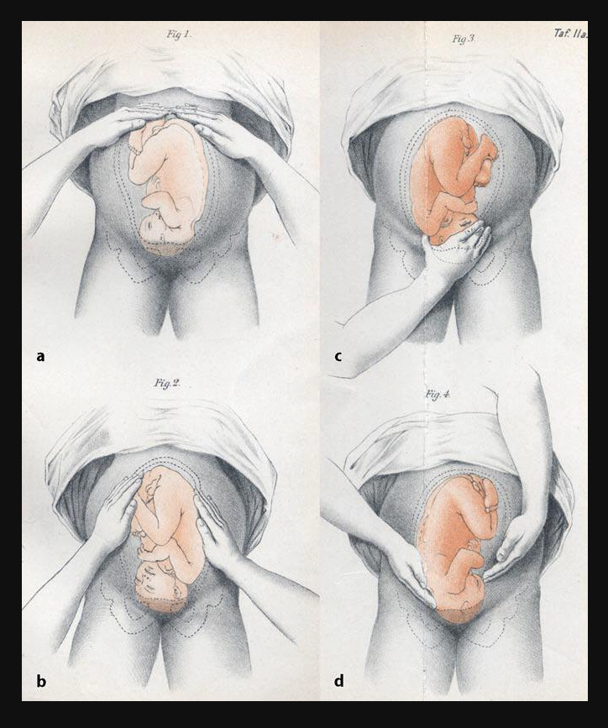
Leopold Maneuvers ^{[12]}
Four examination maneuvers to determine fetal presentation
Presentation – headfirst or buttocks first (Leopolds first maneuver - A)
Lie – location of the fetal back and limbs (Leopolds second maneuver - B)
Engagement – whether the presenting part has dropped into the pelvis (Leopolds third maneuver - C)
Position of head - determination of the brow and back of head (Leopolds fourth maneuver - D)
Credit: Christian Gerhard Leopold, Public domain, via Wikimedia Commons

Slide 54
Video: Leopold Maneuvers ^{[12]}
Notes:
13. Fundamental of Fetal Health Surveillance – Leopold's Maneuvers. University of British Columbia, Continuing Professional Development, Vancouver, British Columbia, Canada. BC CPD Available at https://youtu.be/KQ3L1n5XiLw. Accessed January 3, 2023.

Slide 55
PAs in Obstetrics ^{[13]}
2% of clinicians providing care in Obstetrics & Gynecology are PAs ^{[13]}
Compared with Certified Nurse Midwives (CNM) ^{[13]} , PAs can
preform all CNM duties
assist in surgery
provide ED coverage
provide gynecology care
Women’s Health NPs scope of practice does not include obstetrics or surgical assisting ^{[13]}
Association of PAs in Obstetrics & Gynecology (APAOG) has great resources at https://apaog.wildapricot.org/
Photo credit: Allisyn Brady PA-C
PAs at Cambridge Health Alliance, Cambridge MA ^{[13]}
(from left ) Jerrica Fleurantin PA-C; Allisyn Brady PA-C; Kristen Chase PA-C and Emily Gardner PA-C

Slide 56
References
GLAAD Medial Reference Guide, 11th Edition. Glossary of Terms. Available at https://www.glaad.org/reference/trans-terms?gclid=CjwKCAiAqaWdBhAvEiwAGAQltmO4hBV2EFuM5w3Mh-Wijx1n9Qk_nPuFAu6Rwq9m9O3szbEM621ZyRoCYcsQAvD_BwE. Accessed January 3, 2023.
Feldhusen, AE. The History of Midwifery and Childbirth in America: A Time Line. Midwifery Today. Available at http://www.midwiferytoday.com/articles/timeline.asp Accessed January 3, 2023.
Drife J. The start of life: a history of obstetrics. Postgrad Med J. 2002;78:311-315
Roser M and Ritchie H. (2013) - "Maternal Mortality". Published online at OurWorldInData.org. Retrieved from: 'https://ourworldindata.org/maternal-mortality' [Online Resource]. Accessed January 3, 2023.
American College of Obstetricians and Gynecologists. Methods for Estimating Due Date. Committee Opinion Number 700. May 2017, Reaffirmed 2022. Available at https://www.acog.org/Resources-And-Publications/Committee-Opinions/Committee-on-Obstetric-Practice/Methods-for-Estimating-the-Due-Date. Accessed January 3, 2023.
Chambliss LR, Clark SL. Paper gestational age wheels are generally inaccurate. Am J Obstet Gynecol 2014;210:145.e1-4.
American College of Obstetricians and Gynecologists. Committee Opinion – Definition of Term Pregnancy No 579, November 2013, Reaffirmed 2022. Available at https://www.acog.org/clinical/clinical-guidance/committee-opinion/articles/2013/11/definition-of-term-pregnancy. Accessed January 3, 2023.
American Academy of Pediatrics and the American College of Obstetricians and Gynecologists. Guidelines for Perinatal Care. 8th Ed. Jointly published by AAP and ACOG. ISBN: 978-1-61002-087-9 (AAP) ISBN: 978-1-934984-69-7 (ACOG). 2017.

Slide 57
References
American College of Obstetricians and Gynecologists. Committee Opinion Number 693. Counseling About Genetic Testing and Communication of Genetic Test Results. April 2017. Reaffirmed 2020.Available at https://www.acog.org/clinical/clinical-guidance/practice-bulletin/articles/2016/05/prenatal-diagnostic-testing-for-genetic-disorders. Accessed January 3, 2023
Steele NM, French J, Gatherer-Boyles J, Newman S, Leclaire S. Effect of acupressure by Sea-Bands on nausea and vomiting of pregnancy. J Obstet Gynecol Neonatal Nurs. 2001 Jan-Feb;30(1):61-70. PMID: 11277163.
How to Measure Your Fundal Height. Departments of Obstetrics and Genecology & Midwifery, Jamaica Hospital Medical Center, Queens, NY. Available at https://youtu.be/MFkzEOg4RaU. Accessed January 3, 2023.
Fundamental of Fetal Health Surveillance – Leopolds Maneuvers. University of British Columbia, Continuing Professional Development, Vancouver, British Columbia, Canada. BC CPD Available at https://youtu.be/KQ3L1n5XiLw. Accessed January 3, 2023.
Berkowitz O, White SE. An opportunity for PAs as obstetrical laborists. JAAPA. 2018; 31:40-43. doi: 10.1097/01.JAA.0000529774.75649.c1 PMID: 29369928

